Slide 1
Capstone Project
Hotel Booking Analysis
Team Members
Pendiyala Sai Kumar
Saniya Shakur Shaikh
Pushpendra Pawar

Slide 2
Prephase
Problem Statement
Introduction
Exploring Data Analysis
Challenges
Conclusions

Slide 3
Problem Statements
Which month has heavy traffic?
Booking Rates depends ?
Who does booking?
Why cancellation occurs?
Prefere Hotel type by customer?

Slide 4
Introduction
We have 3yrs of data - 2015-2017.
Hotel: Resort hotel or city hotel.
Is_canceled: 1 or 0 (cancelled or not cancelled).
Lead_time: Time of period for booking.
arrival_date_month: Customer arrived at the hotel in a month.
country: Customer came from a country.
Days_in_waiting_list: After booking the time of delay getting confirmation.
Deposite: No-deposit, Non-Refundable, Refundable.

Slide 5
Introduction
Adr: Average Daily Rate for an occupied room per day.
Adults, Babies, children: Number of Adults, Babies, children.
Assigned Room Type: Type of room assigned to the customer.
Booking Changes: Number of changes.
Distribution_channel: Booking distribution channel.
Is_repeated_guest: Repeated guest(1) or not (0).
Company: ID of the company made the booking.
Market_segment: Market segment designation.

Slide 6
Introduction
Previous_cancellations: Number of previous bookings that were cancelled by the customer prior to the current booking.
Required_car_parking_spaces: Number of car parking spaces required by the customer.
Reservation_status: Canceled – booking was canceled by the customer; Check Out – customer has checked in but already departed; No Show – customer did not check in and did inform the hotel of the reason why.
Reserved_room_type: Code of room type reserved

Slide 7
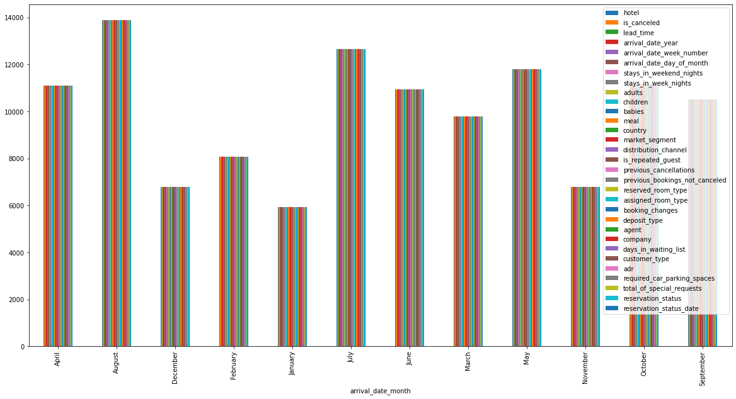
Exploring Data Analysis
Which month has heavy traffic?

Slide 8
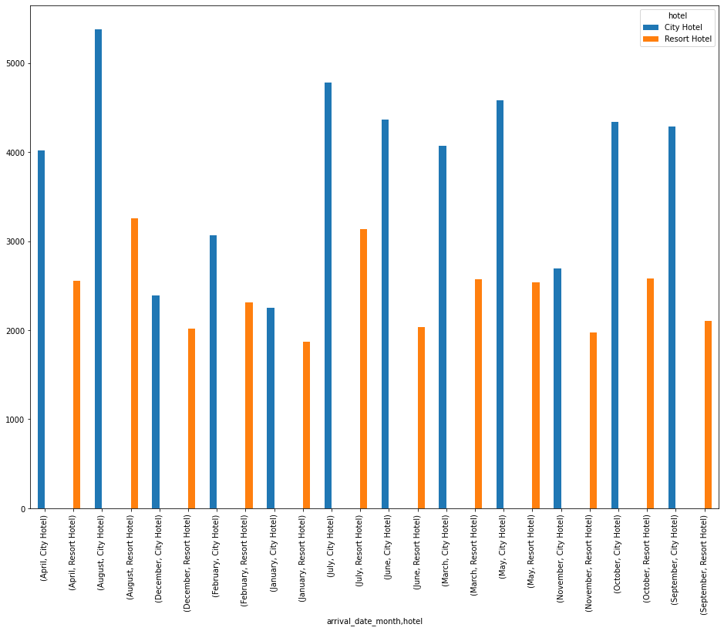
Exploring Data Analysis
Which month has heavy traffic?

Slide 9
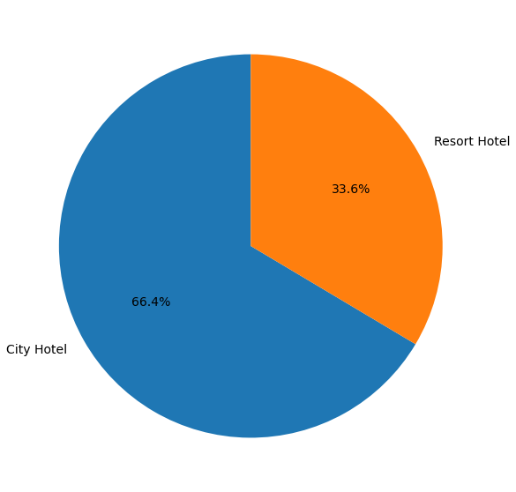
Exploring Data Analysis
Prefere Hotel type by customer?

Slide 10
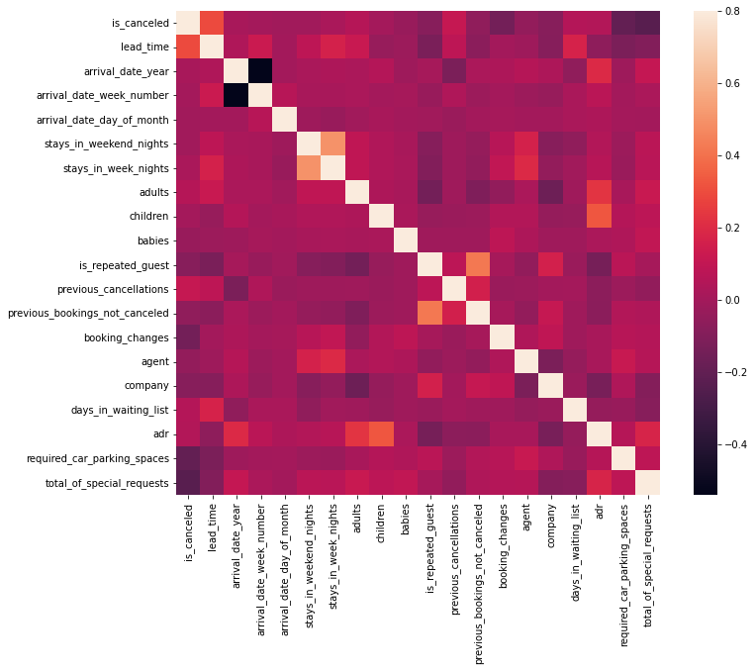
Exploring Data Analysis
Correlation using heat map.

Slide 11
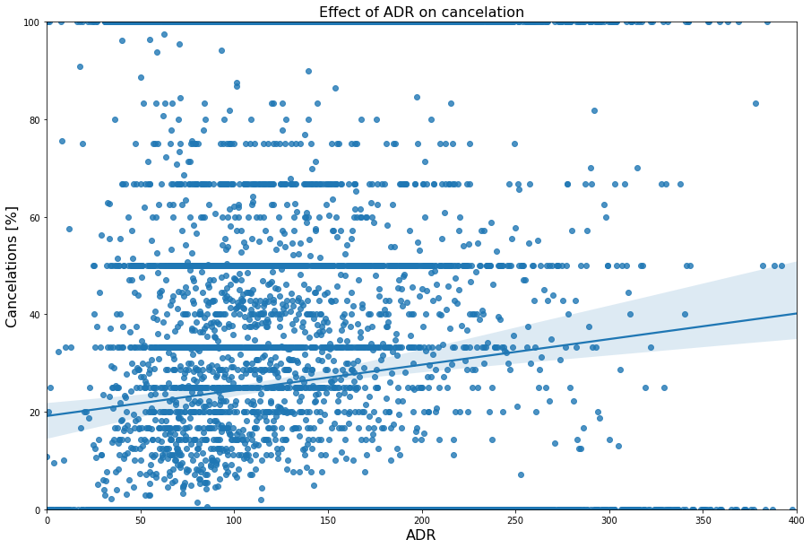
Exploring Data Analysis
Effect of ADR on Cancellation

Slide 12
Challenges
Time taken to find out the problem statement.
Analysis on the dependent variable and independent variable.
To visualize the data in a manner.
Handling missing values.

Slide 13
Conclusions
May to Aug are peak months due to the summer period.
Average Daily Rates (ADR) decreased on Nov-Jan more bookings done.
Exploring Data Analysis
Lead time, Non-Refundable policy and ADR impacts more cancellations

Slide 14
Any Questions ??

